Slide 1
Slope Pavement Under Structures

Slide 2
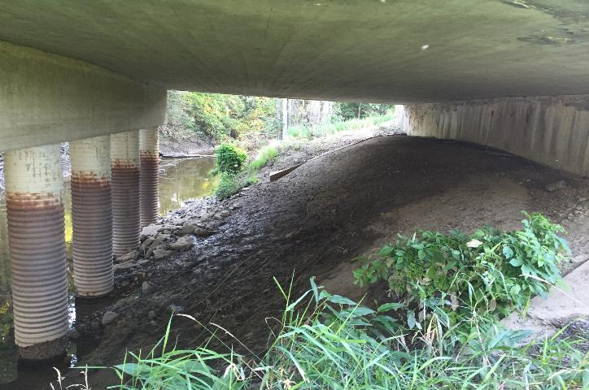
Existing slope under structure along creek alignment
Initial slope conditions with erosion near columns

Slide 3
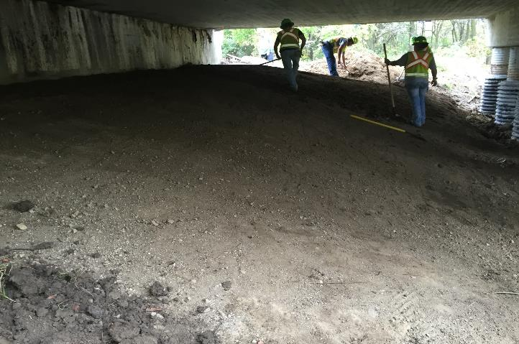
Surface restoration prior to Concrete Cloth GCCM installation

Slide 4
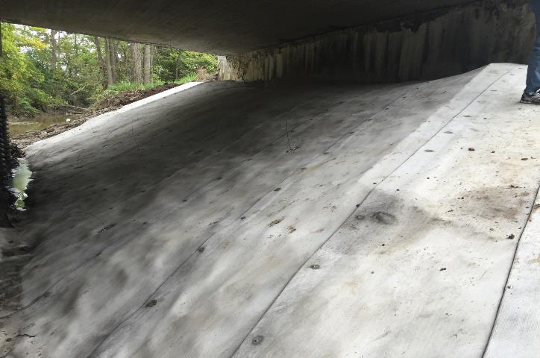
Close-up view of competed installation

Slide 5
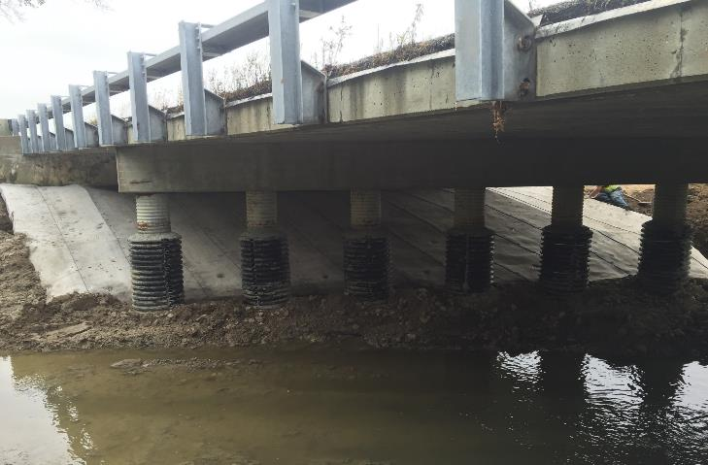
Completed installation, view from opposite bank
M
A

Slide 6
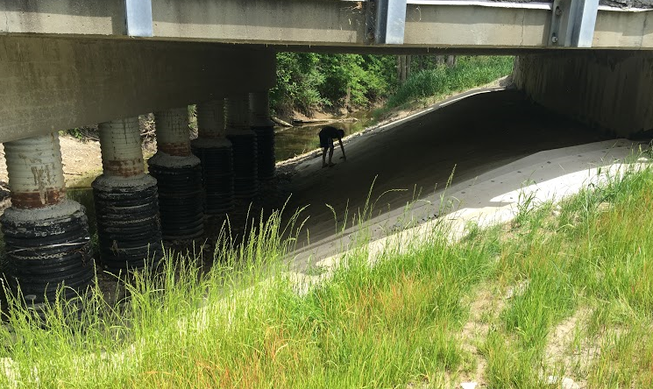

Slide 7
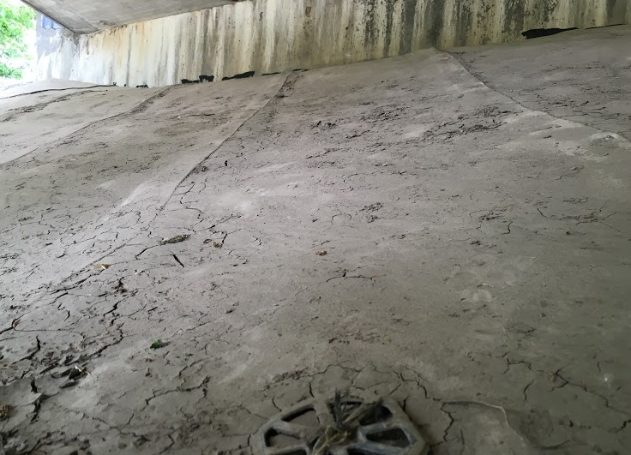
Two 2 year storm events have occurred since installation
The designed 2, 10 and 100 year flow rates are 759, 1310 and 1910 cfs respectively.

